Slide 1
Inflammatory Airways Disorders – Using Biomarkers to target therapy
Jeff Garrett

Slide 2
PERSONALISED (PRECISION) MEDICINE
“The practice of tailoring treatment to individual patients based on their predicted response or risk of disease”
“Precision Medicine requires a different type of clinical trial that focuses on individual , not average, responses to therapy”

Slide 3
Asthma management
Diagnosis….
Phenotypes: clinical (eg allergic, exercise-induced, adult onset, non steroid responsive, Fixed airways obstruction, brittle….)
Endotypes: distinct entities with specific mechanisms
(eg eosinophilic, aspirin–sensitive asthma, obesity related, neutrophilic asthma….)
Systematic Assessment (GORD, VCD, OSA, HVS, Sinusitis, adherence…)
Multidimensional Assessment/Integrated Care
Treatable Traits
Personalised Medicine/Precision Medicine

Slide 4
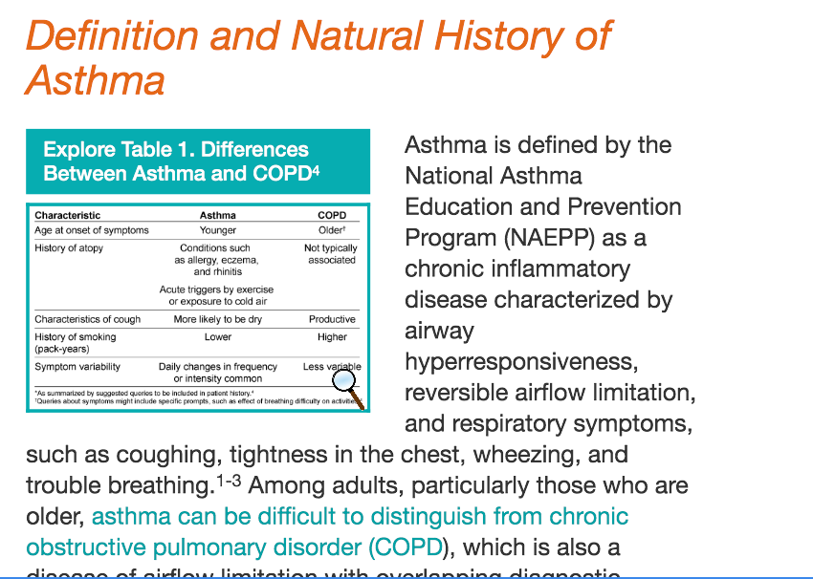
Asthma - Epidemiology

Slide 5
CMDHB residents in 2012 who had a hospital admission with a diagnosis of asthma, COPD, and/or bronchiectasis in the last 10 years (primary and secondary diagnosis),
COPD (n=3,988)
Asthma (n=8,753)
Bronchiectasis (n=1,017)
Prevalence based on hospital coded diagnoses only
3,169
257
483
79
129
552
8,062

Slide 6
Inflammatory Phenotypes of airflow obstruction
Eosinophilic
Neutrophilic
Allergens
??
??
LMW chemicals
Viral infections
Smoking
Bacterial Infections
??
Atopic Asthma
Eosinophilic Bronchitis
Post viral wheeze
Extrinsic Asthma
Intrinsic asthma
Occupational Asthma
COPD
Bronchiectasis
Bronchial Inflammation
Asthma Like
(wheeze)
Bronchitis Like
(Cough and Sputum)
Clinical Science 2002
Notes:
All these conditions can make people wheeze and cause varying degree of bronchial inflammation. Our role in the research clinic is to try and define this
Typical asthma starts at young age with h/o atopy and strong family history and responds well to steroids though some of this group of patients do not have atopy
NEA behaves like COPD and presents as adult onset asthma with fixed airflow obstruction and is common cause for asthma not responding to ICS

Slide 7
Results of Bacci Study: 1000mcg beclomethasone/day for 4 weeks
N = 67 | High Sputum Eosinophils (n=50 or 74% of sample) |  | Low Sputum Eosinophils (n= 17 or 26% of sample)
Variable | Baseline | After 4 wks | Baseline | After 4 wks
Eosinophils (%) | 18.2 (3.1-80.1) | 1.8 * (0 – 14.5) | 1 (0 – 2.7) | 0.6 (0 – 11.9)
Neutrophils (%) | 41 (8.2 – 86.2) | 51.5 (5.6 – 92.2) | 60.6 (26.4 – 94.7) | 62.5 (0 – 82.8)
ECP (μg/L) | 420 (1 – 1,920) | 122 * (4 – 1,010) | 24 (2 – 380) | 68 (4 – 1,432)
Data presented as median (range)
ECP = Eosinophil Cationic Protein
*Significant difference between groups for eosinophils & ECP at baseline p< 0.01
Notes:
Note medians not means presented but see range

Slide 8
Lung function before and after corticosteroid treatment
 | High Sputum Eosinophils |  |  | Low Sputum Eosinophils
Variables | Baseline | After 2 wk | After 4 wk | Baseline | After 2 wk | After 4 wk
FEV1, % predicted | 87.9 ± 15.4 | 97.3 ± 14.5§ | 96.9 ± 14.5§ | 90.2 ± 17.3 | 91.7± 17.7 | 91.2± 20.0
Bacci Chest 2006;129(3):565-72

Slide 9
Steroids on eosinophils
‘Effect of Corticosteroids on Eosinophil Chemotaxis and Adherence’ – Journal Clinical Investigations 1981; 67 (1) : 28-36
Results:
  Eosinophil adherence is transiently reduced by steroids
  Eosinophil chemotaxis is inhibited by steroids
  Chemotaxis inhibiting (not inactivating) effect is nontoxic, cell-directed, dose-dependent and reversible
  Inhibition of eosinophil adherence and chemotaxis in part explains how corticosteroids produce eosinopenia and reduce local accumulation of eosinophils.
  No effect on Neutrophils may increase pathogenic bacterial proliferation (predominant cause of neutrophilic inflammation)

Slide 10
The ideal biomarker
Indicates a key pathophysiological process
May be used to distinguish a particular phenotype (eg eosinophilic, neutrophilic, mixed, paucigranulocytic)
Is responsive to changes in disease activity
Is responsive to changes in pathophysiology mediated by treatment intervention
Is responsive within a time frame which precedes changes in clinical status and permits pre-emptive interventions
Is easily measured
Is minimally invasive
Is reproducible
Is properly validated

Slide 11
Airway Inflammation
Underlying pathology in asthma (+impt in COPD)
No good test to measure degree of airway inflammation
Biomarker measurement:
bronchoscopy: BAL/bronchial biopsy
induced sputum
exhaled nitric oxide (eNO)
blood eosinophil level
Not widely available outside clinical trials but changing

Slide 12
Utility of Biomarkers –”Inflammometry”
The use of information gathered from measures of airway inflammation to guide assessment and treatment.
Success with induced sputum eosinophil counts.
(Gold standard)
Predicts steroid responsive disease
A rise in counts measured longitudinally predicts subsequent loss of asthma control
Management protocols aimed at titrating steroid therapy to maintain normal counts lead to superior asthma control
Pavord 1999
Pizzichini 1999
Brightling 2000
Green 2002
Jatakanon 2000
Deykin 2004
Green 2002 Jayaram 2005
Chlumsky 2006

Slide 13
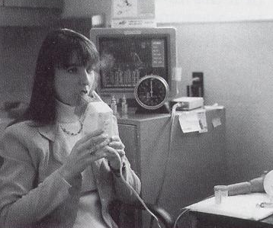
Sputum induction and examination
Sputum induction
  B₂ agonist
2 methods
success rate
Safety ( BHR)
children
low FEV₁
Notes:
Over last 20 years sputum examination has evolved as direct, relatively non invasive, valid, and repeatable method of measuring Airway Inflammation.

Slide 14
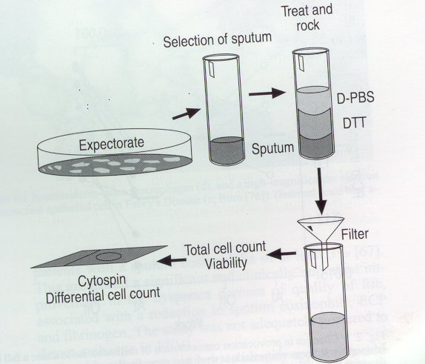
Sputum examination
Notes:
Processed in laboratory which results in a cell pellet being examine under the microscope for a cell count

Slide 15
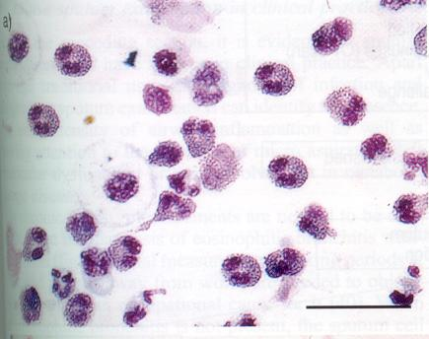
Sputum: causes of increase in
cell type
Eosinophilic: uncontrolled asthma, non compliance with medications, occupational asthma, steroid responsive smoking related COPD (15-25%)
Neutrophilic: irritants - cigarettes, occupational (lower)
        infections – bacterial, viral (higher)
Notes:
Normal values established eo<2%
Explain features of eosinophil

Slide 16
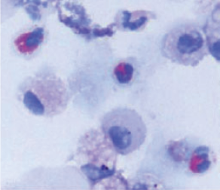
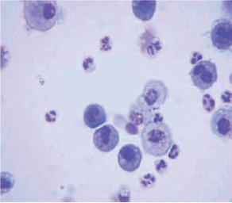
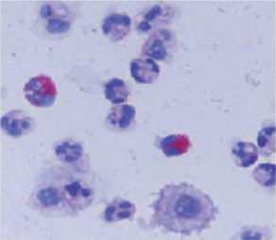
41%
31%
eosinophils
> 1.01%
neutrophils
> 61%
Eosinophilic
Paucigranulocytic
20%
8%
Neutrophilic
Mixed

Slide 17
The ideal biomarker
Indicates a key pathophysiological process
May be used to distinguish a particular phenotype (eg eosinophilic, neutrophilic, mixed, paucigranulocytic)
Is responsive to changes in disease activity
Is responsive to changes in pathophysiology mediated by treatment intervention
Is responsive within a time frame which precedes changes in clinical status and permits pre-emptive interventions
Is easily measured
Is minimally invasive
Is reproducible
Is properly validated

Slide 18
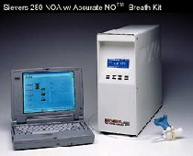
Exhaled nitric oxide
Measured by rapid linear-response chemiluminescence
standardised measurement
  50 ml/sec flow rate
  reproducible,discriminates between subjects with and without asthma
  Results influenced by number of factors eg ICS, LABAs, smoking…..
normal values: mean (SD) 12 (11) ppb
  10th percentile: 6 ppb
  90th percentile: 23 ppb
Notes:
inspire to TLC via mouthpiece to remove nitric oxide in ambient air the exhale maintaining a constant pressure ( as produces fixed flow and ENO is flow dependent)

Slide 19
Factors thought to influence exhaled NO
NO
NO
(Genetic factors)
Viral infections
Atopy and AHR
Smoking
Corticosteroids
Acute lung allograft rejection? Bronchiectasis
Female sex hormones
SLE
Liver cirrhosis
Pulmonary hypertension
Immunodeficiency
Primary Ciliary Dyskinesia
Cystic Fibrosis
Factors that effect exhaled NO independent of sputum eosinophils will result in discordance between the 2 variables.

Slide 20
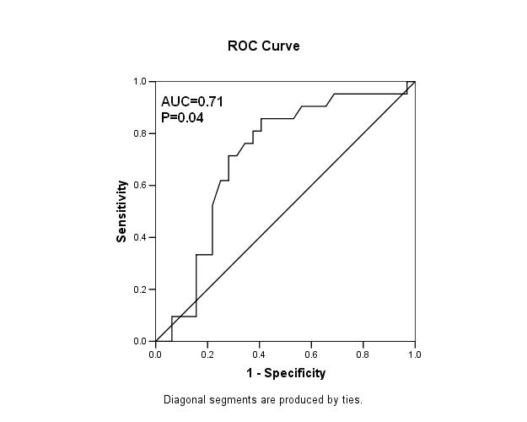
ROC curve of eNO predicting positive eosinophilia –
Yap E, Garrett J, Jayoram L. Int Med J 2013
Sputum eosinophils
<3%
≥ 3%
< 20
FeNO
ppb ≥ 20
7 | 8
6 | 31
Cut point of 20 has sensitivity (31/39) 79%, specificity (7/13) 54%

Slide 21
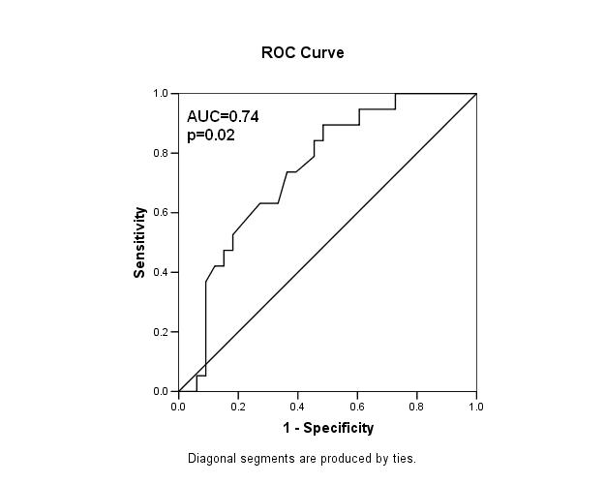
ROC curve of serum eosinophils predicting positive eosinophilia
Sputum eosinophils
<3%
≥ 3%
Serum <0.35 eosinophils
≥ 0.35
21 | 6
12 | 14
Cut point of 0.35 has sensitivity 14/20=70%, specificity 21/33=64%

Slide 22
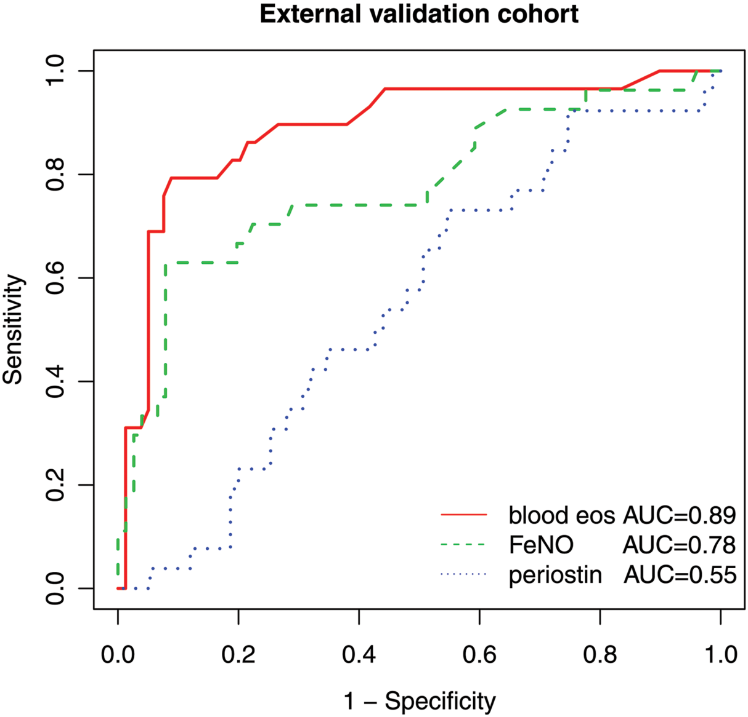
Receiver operating characteristics curve analyses of the
sensitivity and the specificity of blood eosinophils, FENO and
serum periostin for the diagnosis of eosinophilic
inflammation. AUC, area under the curve.
Wagener AH, et al. Thorax 2014;

Slide 23
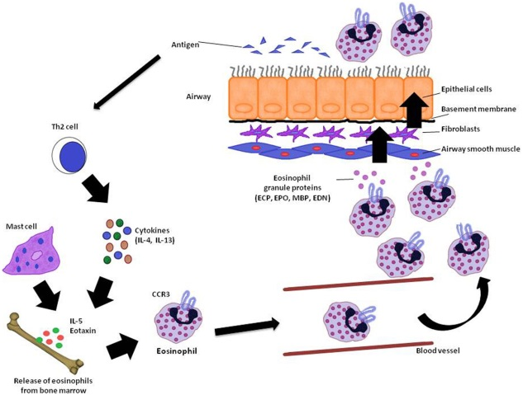

Slide 24
ROC curve of serum eosinophils at predicting +ve sputum neutrophils (>76%)
Cut point of 0.23 has sensitivity 65%, specificity 53% (p=0.03, n=508) Schleich et al. Personal communication

Slide 25
Serum Eosinophil Level as a biomarker (Eosinophil/wcc x 100 >2 %)…Pavord et al
Antibiotics
Steroids
Neutrophils
Eosinophils
0 0.15 0.25 0.5
x10⁹/litre

Slide 26
Universal goal of clinicians and patients
Personalised medicine is treating
  the right patient
  with the right treatment/medication
  at the right time in the course of the disease
  to achieve the right outcome

Slide 27
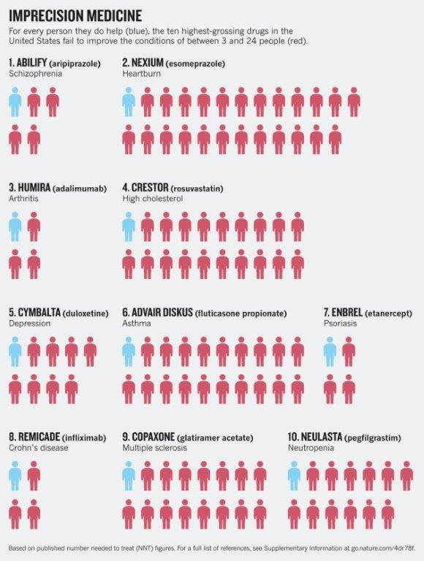
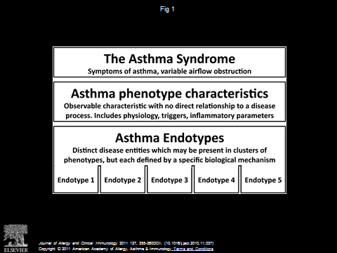

Slide 28
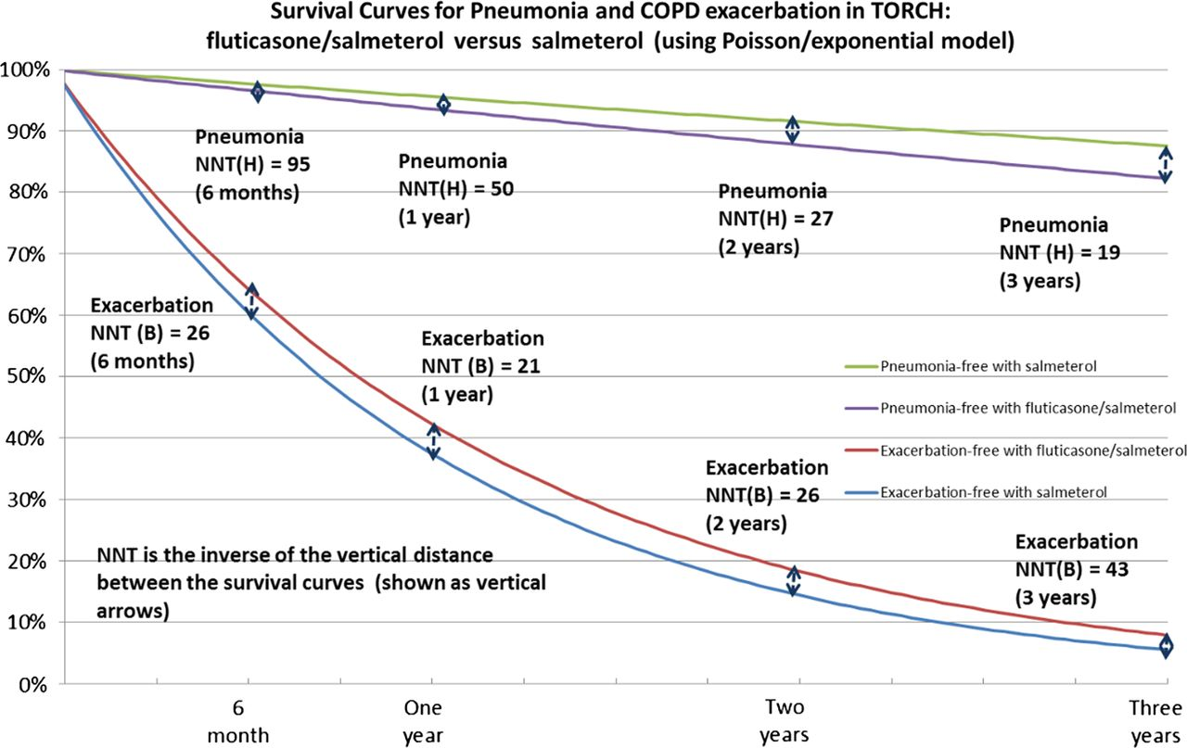
Adverse Effects vs Benefits of Fluticasone in COPD

Slide 29
Overlap between COPD and Pneumonia in CMDHB
Year | Primary diagnosis of COPD without pneumonia | COPD with Pneumonia as secondary diagnosis | Pneumonia as primary diagnosis with COPD as secondary diagnosis | Percentage of COPD patients with pneumonia
2000/2001 | 580 | 23 | 220 | 30%
2001/2002 | 644 | 102 | 202 | 32%
2002/2003 | 647 | 94 | 133 | 26%
2003/2004 | 749 | 120 | 121 | 24%
2004/2005 | 786 | 135 | 102 | 23%
2005/2006 | 761 | 147 | 61 | 21%
2006/2007 | 837 | 115 | 75 | 19%
2007/2008 | 867 | 82 | 83 | 16%
2008/2009 | 905 | 70 | 86 | 15%
2009/2010 | 801 | 97 | 82 | 18%
2010/2011 | 937 | 100 | 85 | 16%
2011/2012 | 962 | 138 | 85 | 19%
2012/2013 | 1,070 | 127 | 113 | 18%
Notes:
NZ nationally had fallen from 24% to 20%
29

Slide 30
Blood eosinophils as a biomarker in COPD
High baseline blood eosinophils counts predict
  Future exacerbations
  Future severe exacerbations
  Response to inhaled steroids (ICS + LABA vs LABA studies)
    Reduced exacerbations
    Improved quality of life
Selected cutoffs – relative or absolute
  2% cells (%= eosinophils/total wbc)
  0.15 x 10⁹cells/L
  0.3 x 10⁹ cells/L
Notes:
Sputum evidence of eosinophilic airway inflammation is present in 20 to 30% of patients with COPD during stable periods and acute exacerbations.

Slide 31
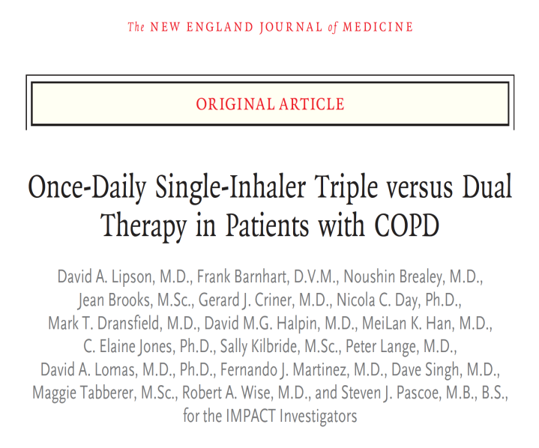
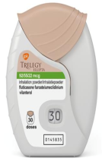
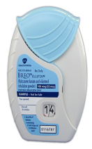
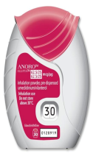
IMPACT study
Informing the Pathway of COPD Treatment study
RCT with 10,355 patients
Randomised to once daily treatment with:
  Triple therapy (Fluticasone furoate 100µg (ICS), Umeclidinium 62.5µg (LAMA), Vilanterol 25µg (LABA)
  ICS-LABA (Fluticasone - Vilanterol)
  LAMA-LABA (Umeclidinium – Vilanterol)
vs
vs
Lipson et al. New Engl J Med 2018

Slide 32
Patients enrolled into study
40 years or older
Symptomatic COPD: CAT score ≧10
FEV1 < 50% and at least one moderate or severe exacerbations in past year
Or FEV1 50-80% and at least 2 moderate or 1 severe exacerbation in past year (GOLD
(GOLD groups B or D)
Patients took their own inhalers during the 2 week run-in before randomisation…..70% on ICS!!!!

Slide 33

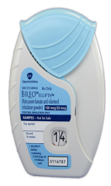

Primary endpoint
Moderate or severe exacerbations
  Triple therapy 0.91 per year
  ICS – LABA 1.07 per year
  LAMA – LABA 1.21 per year
Triple therapy vs ICS-LABA
  15 % less exacerbations (p<0.001)
Triple therapy vs LAMA-LABA
  25% less exacerbations (p,0.001)

Slide 34
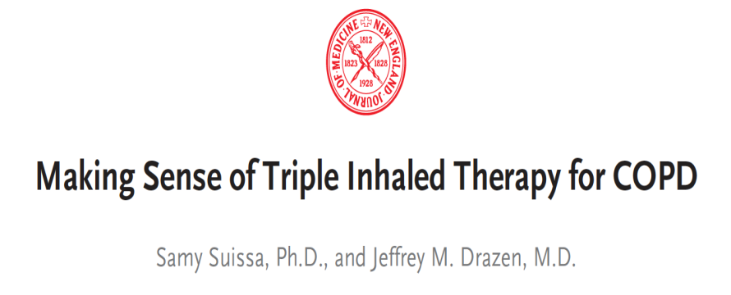
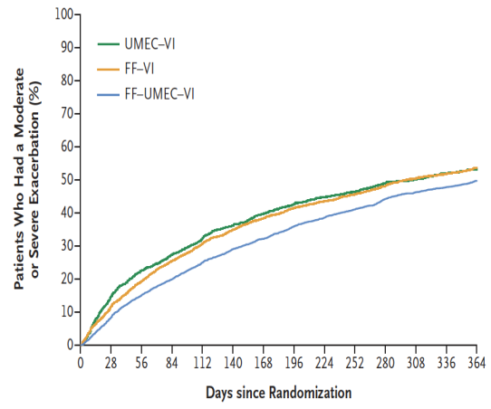
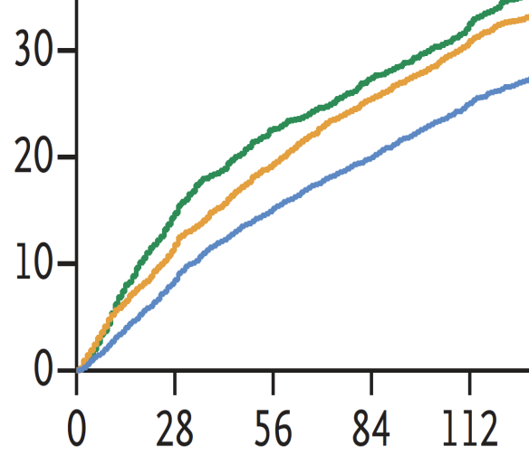
Editorial
Strengths of the study
  Addresses key question of step up from LAMA-LABA to triple therapy
  Same drugs, doses, and inhaler in dual vs triple therapy
But study is difficult to interpret
  At enrolment, 40% were on triple therapy, 70% were taking an inhaled steroid
  Also patients with coexisting asthma were included
  Inhaled steroids were abruptly withdrawn at start of study
  Could explain the rapid surge in exacerbation in LAMA-LABA group in first month. Exacerbations were similar for next 11 months
Inadequate evidence for widening the use of inhaled steroids in COPD. Recommend limit ICS for GOLD Group D patients.
Suissa et al. New Engl J Med 2018

Slide 35
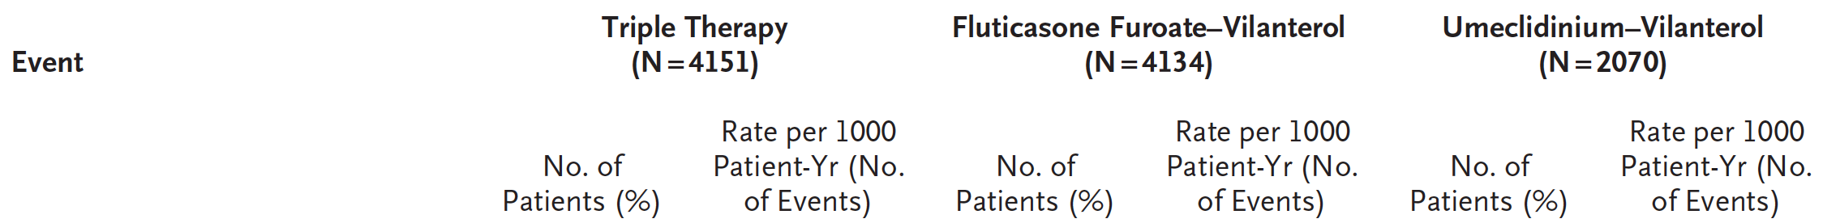
Increased risk of pneumonia from inhaled steroids
Risk of physician-diagnosed pneumonia was increased by 53% in the inhaled steroid groups compared to LAMA-LABA group (p<0.001)

Slide 36
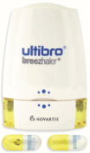
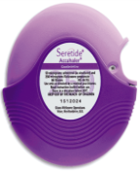
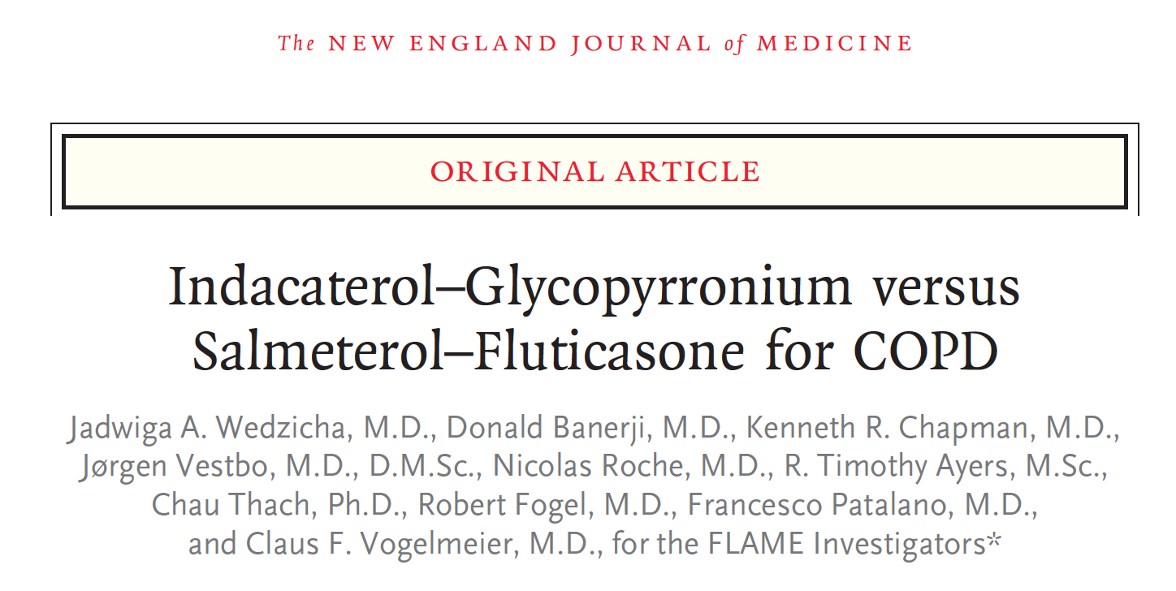
But …
vs
Study conflicts with the FLAME study
  LAMA-LABA vs ICS-LABA
  1680 patients with COPD
  LAMA-LABA was superior to ICS-LABA
    17% less moderate or severe exacerbations
    Superior regardless of eosinophil levels
Conflict likely due to design and population differences
  FLAME – 4 week run-in with tiotropium
  IMPACT – Stayed on usual medications before randomisation
Wedzicha et al. New Engl J Med 2016
Notes:
FLAME – likely run-in would have resulted in those stopping ICS have exacerbations and withdrawing. Therefore less patients who would benefit from ICS. Also patients on ICS who could not stop ICS may not have been enrolled.
IMPACT – If on ICS and randomised to LAMA-LABA then will have more exacerbations.

Slide 37
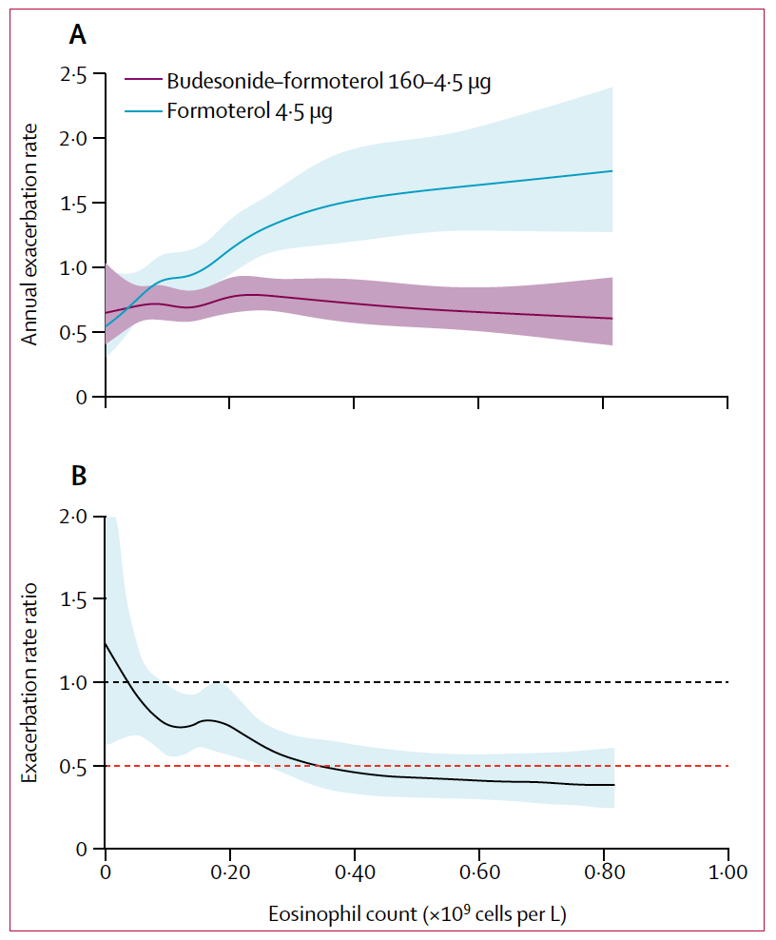
Inhaled budesonide and risk of exacerbations according to blood eosinophil counts
Post-hoc analysis of 3 RCTs
  ICS+LABA vs LABA
  Budesonide-formoteral vs formoterol
  N = 4528
  Baseline median eosinophil count
    0·18 × 10⁹ cells per L (IQR 0·11–0·28)
  Analysis of eosinophils as a continuous variable
Main conclusions
  Exacerbation frequency increases with increasing blood eosinophil count
  Budesonide-formoterol reduced exacerbations
  If on ICS/BUD, the rate of exacerbations is independent of eosinophil count
  Blood eosinophil count predicts response to ICS
No effect of ICS
50% reduction
Bahfadel et al. Lancet Resp Med 2018

Slide 38
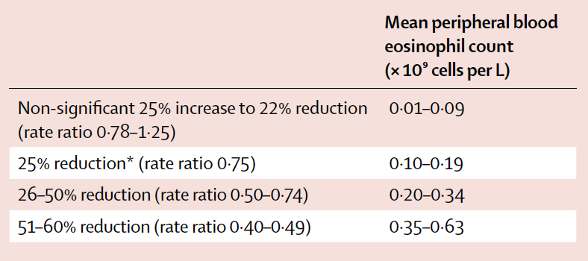
Exacerbation rate reduction treatment effect according to eosinophil count
Budesonide–formoterol vs formoterol
Treatment effect of inhaled steroid occurred at a minimum eosinophil count of 0.1 x 10⁹/L
Implies that most COPD patients (79%) would benefit from ICS-LABA combination
Bahfadel et al. Lancet Resp Med 2018

Slide 39
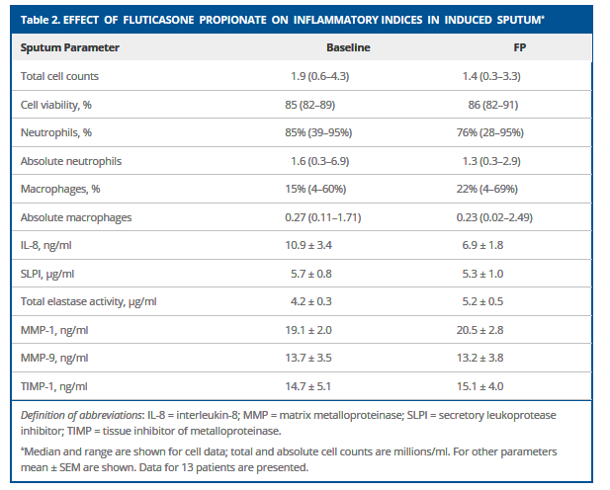
Effect of Fluticasone 500ug twice daily on inflammatory indices in induced sputum in COPD

Slide 40
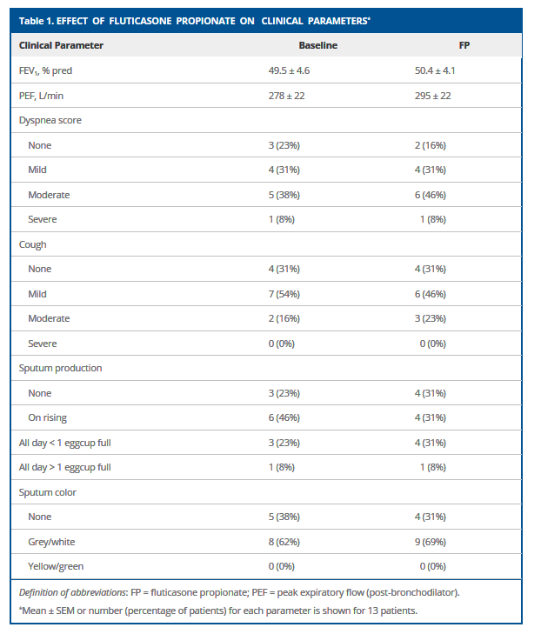
Effect of Fluticasone 1000ug on clinical parameters COPD

Slide 41
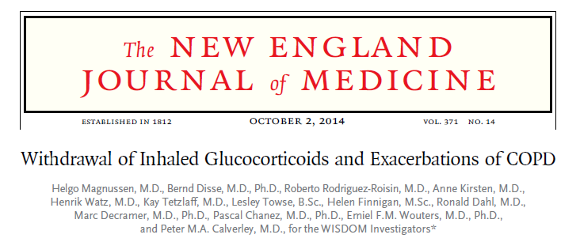
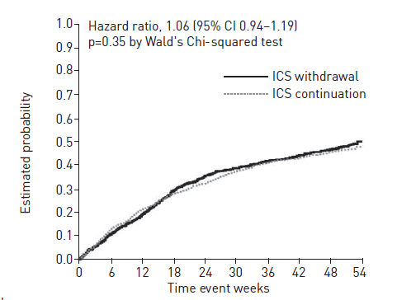
WISDOM study
Triple therapy
  Tiotropium, salmeterol, fluticasone
  Withdrawal of fluticasone
No increase in moderate or severe exacerbations
But greater decline in FEV1 (43ml)
Interpretation: ICS good or bad?
Lancet Resp Med 2016
  Posthoc analysis suggested increased risk in those with high blood eosinophils (0.3 x10⁹/L)
GOLD 2018: ‘withdrawal studies provide equivocal results’ for lung function symptoms and exacerbations.
n-=2485

Slide 42
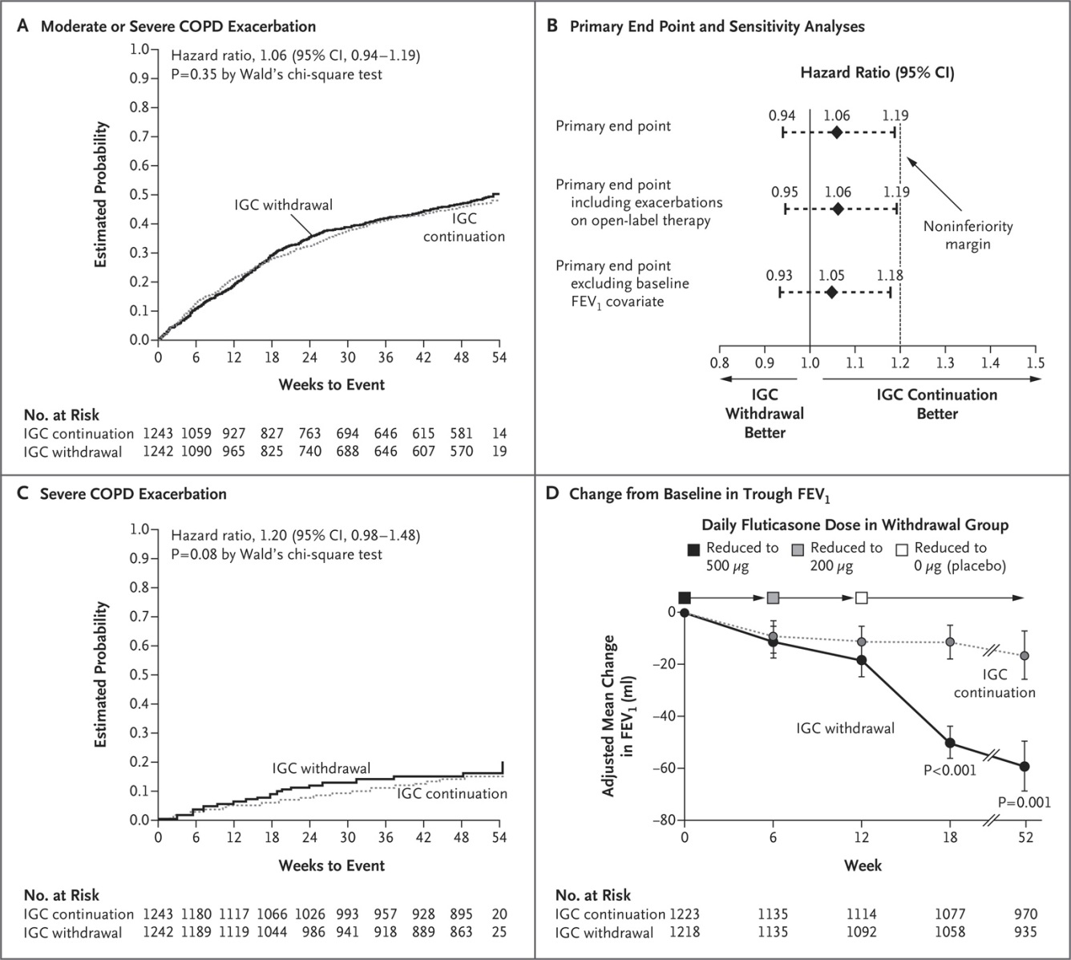
COPD exacerbations and lung function
Magnussen H et al. N Engl J Med 2014;371:1285-1294

Slide 43
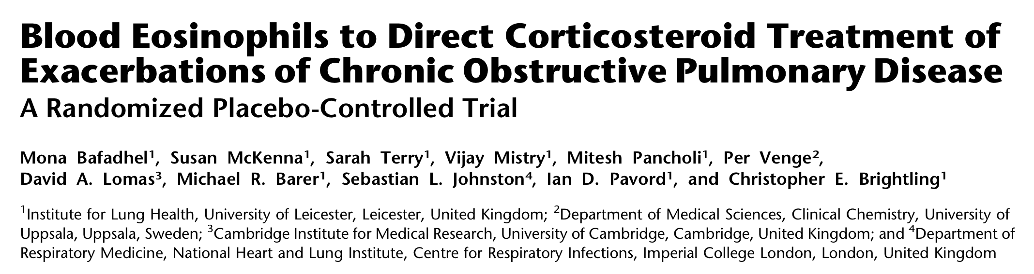
American Journal of Respiratory and Critical Care Medicine, Vol 186 (48-55) – July 1 2012

Slide 44
Some ‘accepted’ facts for study:
Eosinophilic airway inflammation is important in pathogenesis of severe COPD exacerbations
    ‘Eosinophilic airway inflammation and exacerbations of COPD : a randomized controlled trial’ – Eur Resp Journal 2007; 29: 906-913
Airway eosinophilia is associated with corticosteroid responsiveness in COPD
    ‘Eosinophilic airway inflammation in COPD’ – Int Journal of COPD 2006:1 (1) -39-47

Slide 45
Peripheral eosinophilia is a sensitive and specific biomarker for airway eosinophilia during COPD exacerbations.
    ‘Acute Exacerbations of COPD – Identification of Biologic Clusters and Their Biomarkers’ – American Journal of Respiratory and Critical Care Medicine, Vol 184 (662-671), 2011

Slide 46
Biomarker phenotype stability
  Blood eosinophil biomarker status at baseline had an odds ratio (OR) of 5.5 for predicting the blood eosinophil biomarker status at exacerbation

Slide 47
Methods:
  Randomized into biomarker-directed double blind corticosteroid versus standard therapy study
  Standard arm – 30 mg prednisone for 2 weeks
  Biomarker directed arm – 30 mg prednisone or matching placebo according to eosinophil count biomarker
  Everyone received antibiotics – amoxil/doxycycline for 7 days
  Blood eosinophils measured to define biomarker-positive and negative exacerbations (blood eosinophil > and ≤ 2% (eosinophil/wcc x 100/1) respectively)
    Cutoff aimed at high sensitivity to ensure prednisone treatment in all subjects with a sputum eosinophilia

Slide 48
COPD pts <2% blood eosinophils results
Results: Biomarker negative (eosinophil <2%) exacerbations prescribed placebo vs prednisone
Biomarker (-ve) given placebo > improvement in Symptom score @ 2 weeks (p=0.05)
Biomarker (-ve) given prednisone > Rx failures (15 vs 2%, p=0.04)
Biomarker (-ve) given prednisone > % no improvement in symptoms (21 vs 4%, p=0.03)
No difference in FEV1

Slide 49
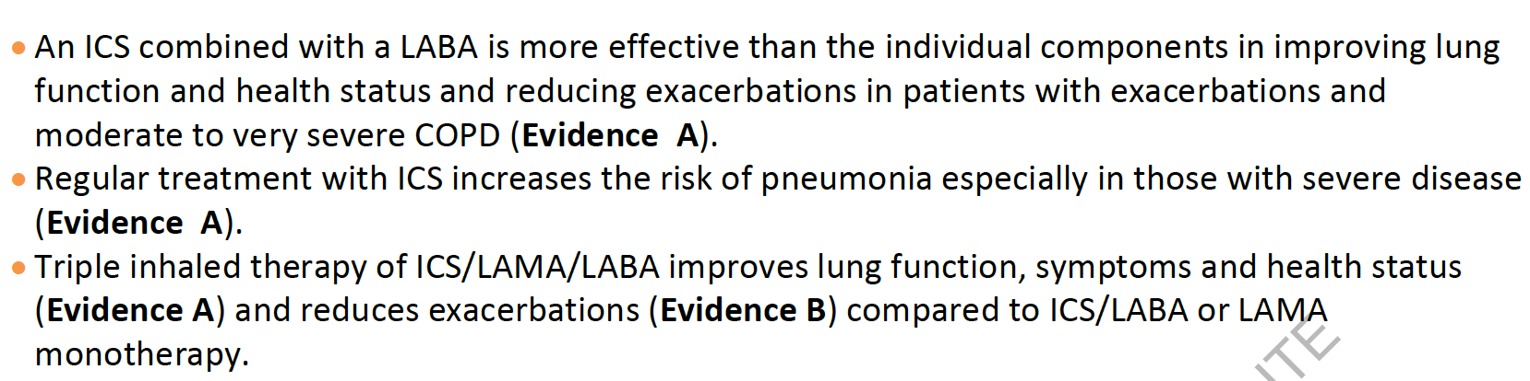
GOLD 2018 - inhaled steroid treatment
No studies comparing ICS/LAMA/LABA with LAMA + LABA combination

Slide 50
Summary
Blood eosinophils are a useful but imperfect marker in COPD (and asthma)
  Predict exacerbations and response to inhaled steroids
  Below cutpoint of 0.15 x10⁹ cells/L – inhaled steroids unlikely to be effective
Inhaled steroids have a role in the treatment of COPD
  Symptomatic GOLD group D COPD with frequent exacerbations and eosinophils >0.15 or 2%
  However, pneumonia risk is increased by 50% (dose and type of steroid related)
It is likely that some COPD patients outside Group D will benefit from inhaled steroids ie those with increased eosinophils ?>0.15 or 0.2
  We should be careful in starting inhaled steroids in COPD patients
  We should also be cautious about stopping inhaled steroids in patients with COPD. (Suggest LABA/LAMA plus ICS and reduce ICS over time with eosinophil monitoring)
    Particularly as ‘Asthma’ and ’COPD’ are not able to be readily diagnosed or separated.

